Slide 1
Import OData
Import OData

Slide 2
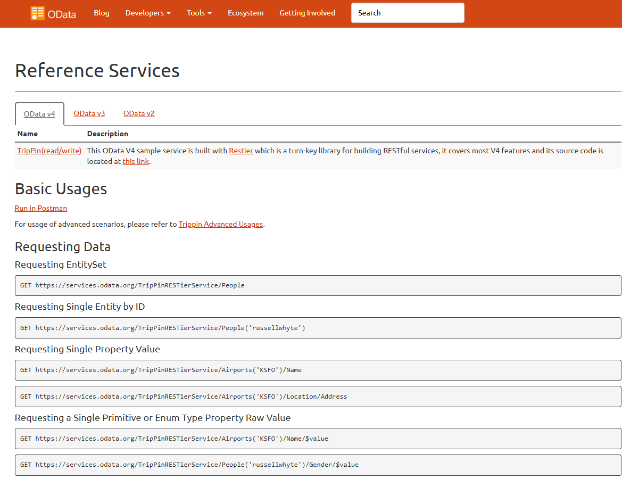
Importing OData
Open the website www.odata.org/odata-services and choose a link to a dataset entity

Slide 3
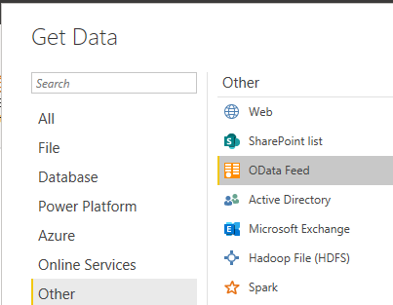
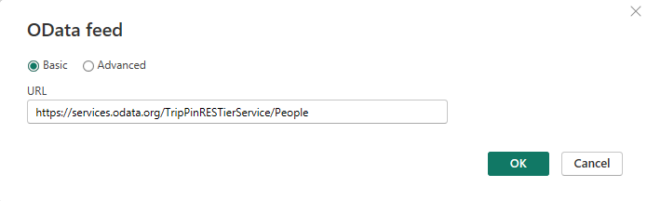
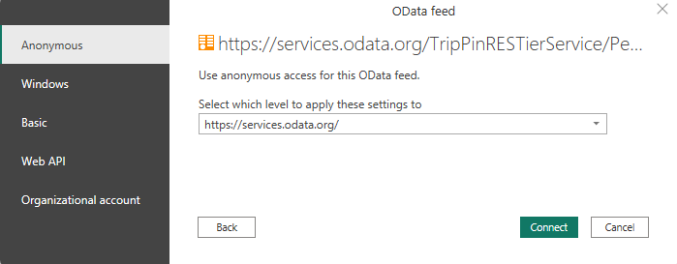
Importing OData
Select Web as data source
URL field, enter the link

Slide 4
Thank you
Thank you

